Slide 1
Welcome
To
our Presentation

Slide 2
Team Member
Monisha Biswas
181-15-1928
Noor Afia Shammi
181-15-1994
Sabbir Ahamed
181-15-1928
Md.Yeasin Sheikh
181-15-2049

Slide 3

Topic
Online Education Vs. Traditional Learning
……………………………………………………..

Slide 4
Traditional Education system
Noor Afia Shammi 181-15-1928

Slide 5
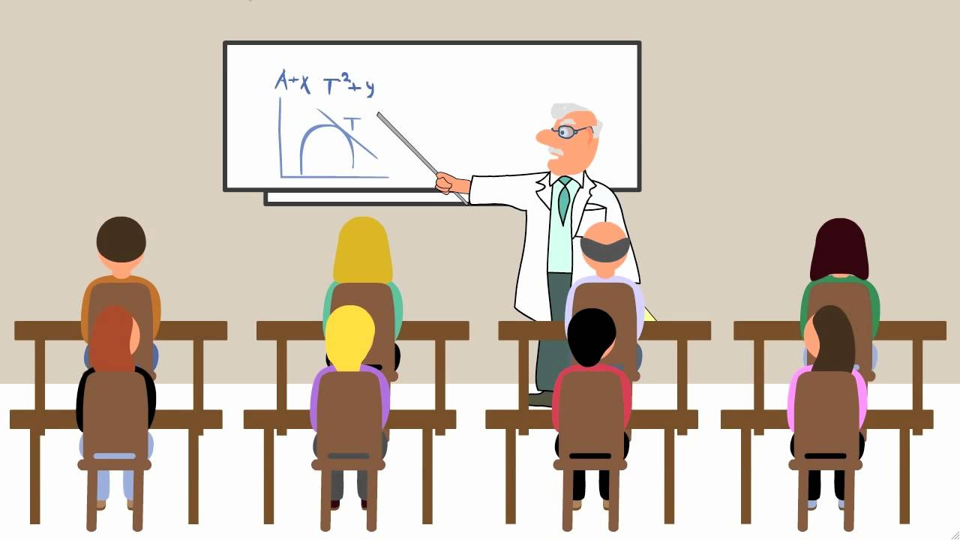
Traditional Education ?
Teacher-centered delivery of instruction to classes of students who are the receivers of information.

Slide 6
Advantages of Traditional Education
Active learning
Interaction and communication
Scheduled learning
Social benefits
Extra-curricular activities

Slide 7

Disadvantages of Traditional Education
Costly
Students’ dependence on Teachers
Favoritism
Negative Groups
Extracurricular Activities distort students

Slide 8
Online Education system
Monisha Biswas
181-15-1928

Slide 9

Online Education ?
Any kind of learning that takes place via the Internet.

Slide 10
Advantages of Online Education
Career advancement and hobbies
Flexible schedule and environment
Lower costs and debts
Self-discipline and responsibility
More choice of course topics

Slide 11
Disadvantages of Online Education
Lack of accreditation and low quality
Little or no face-to-face interaction
More work
Intense requirement for self-discipline
Even more intense requirement for self-direction

Slide 12
Online Education is good ?

Slide 13
Difference between Online & Traditional Education
Sabbir Ahmed
181-15-1996

Slide 14
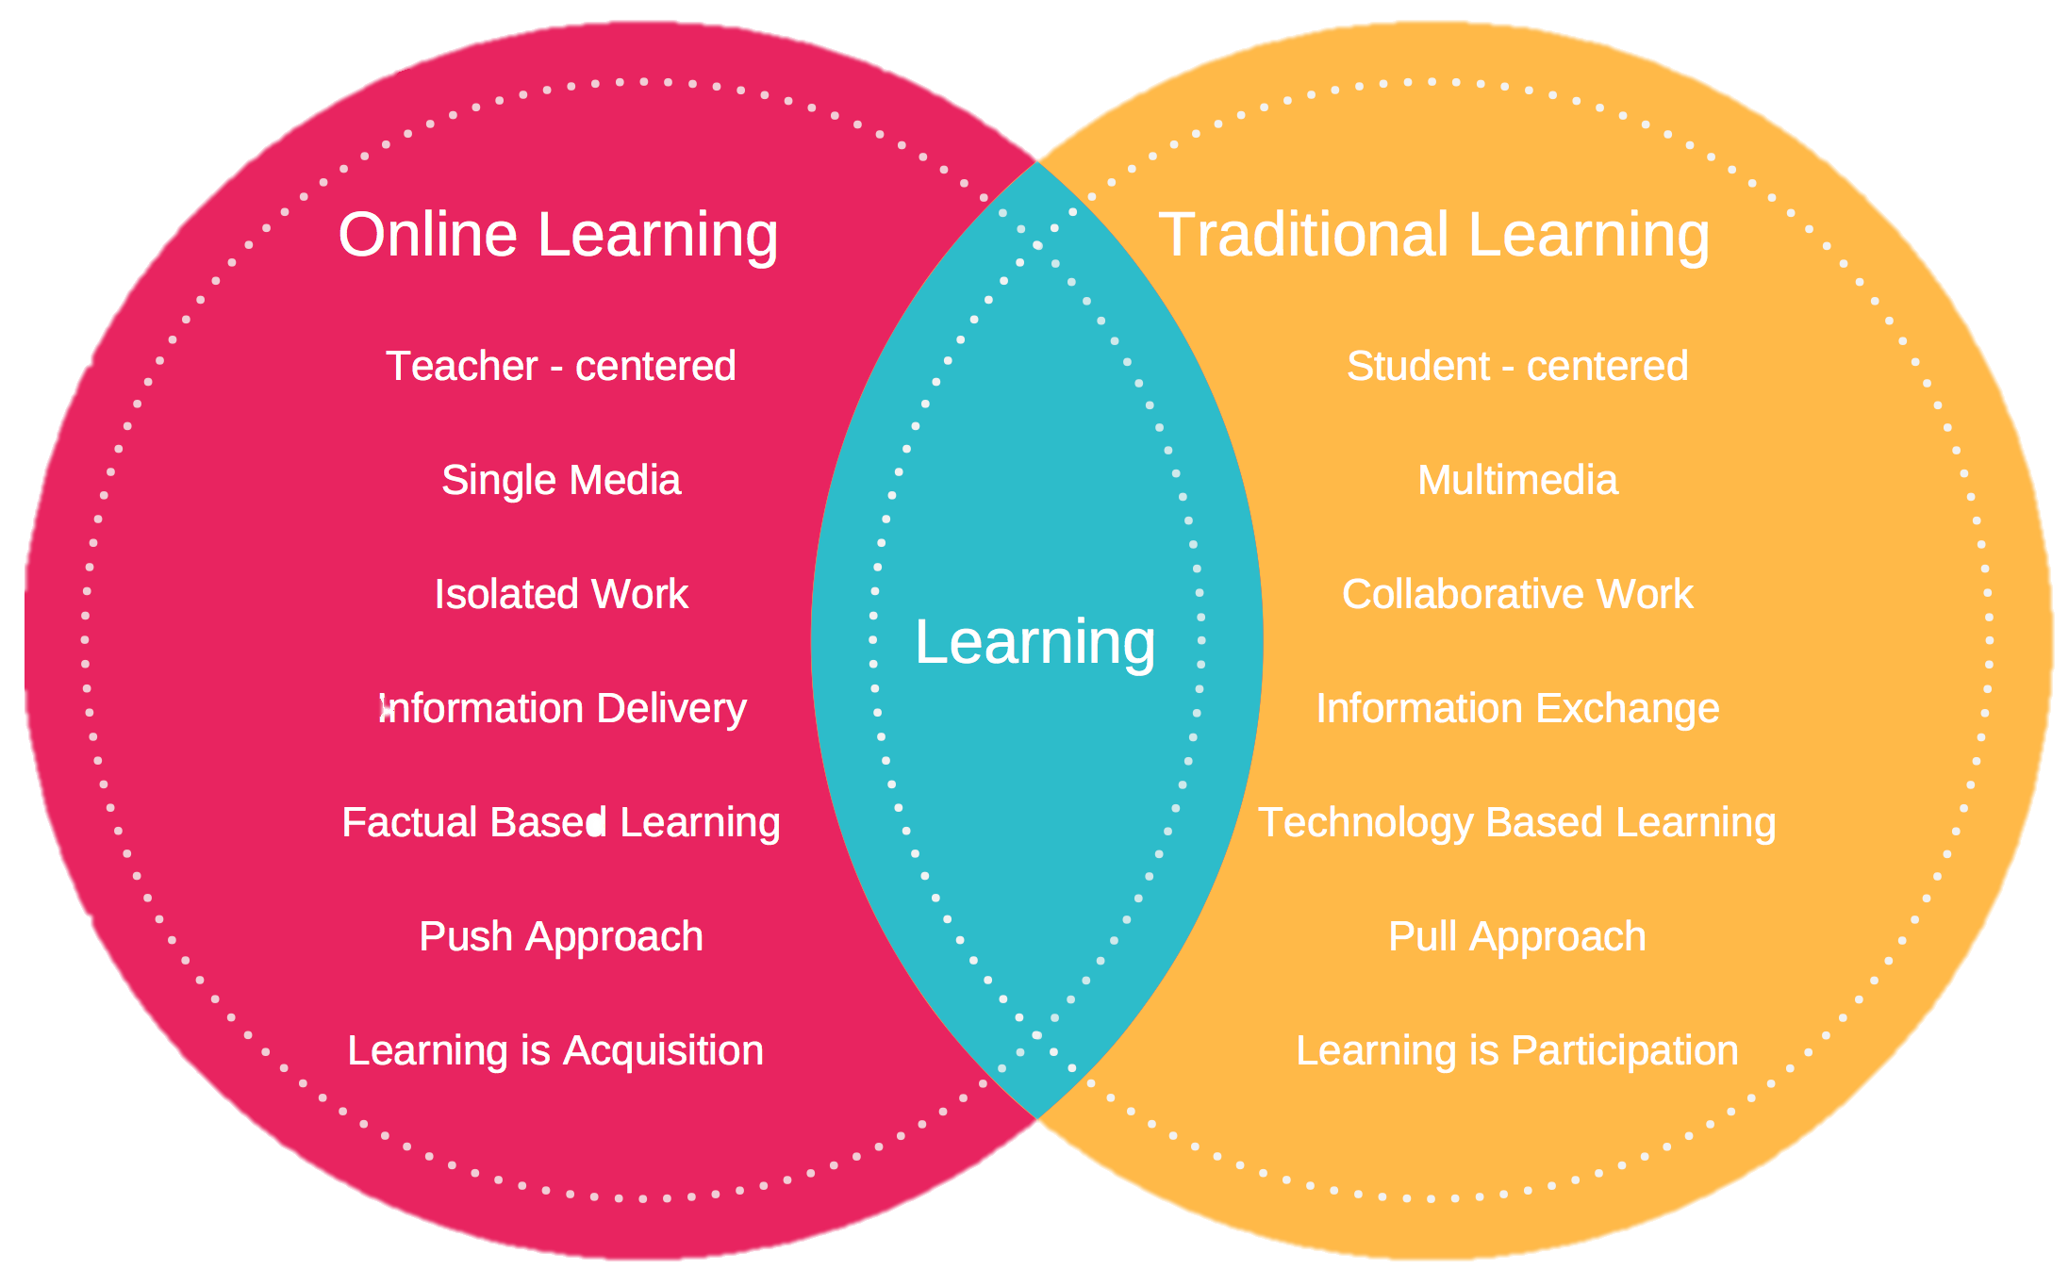
Difference between Online & Traditional Education

Slide 15
Making the right decision
Md.Yeasin Sheikh
181-15-2049

Slide 16
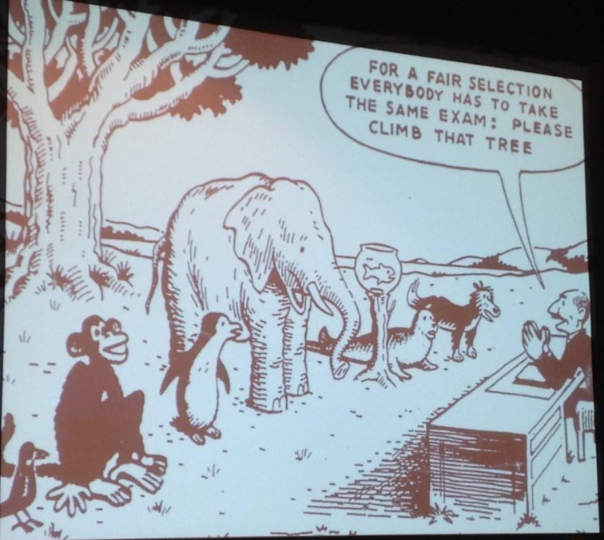

Today’s Education

Slide 17
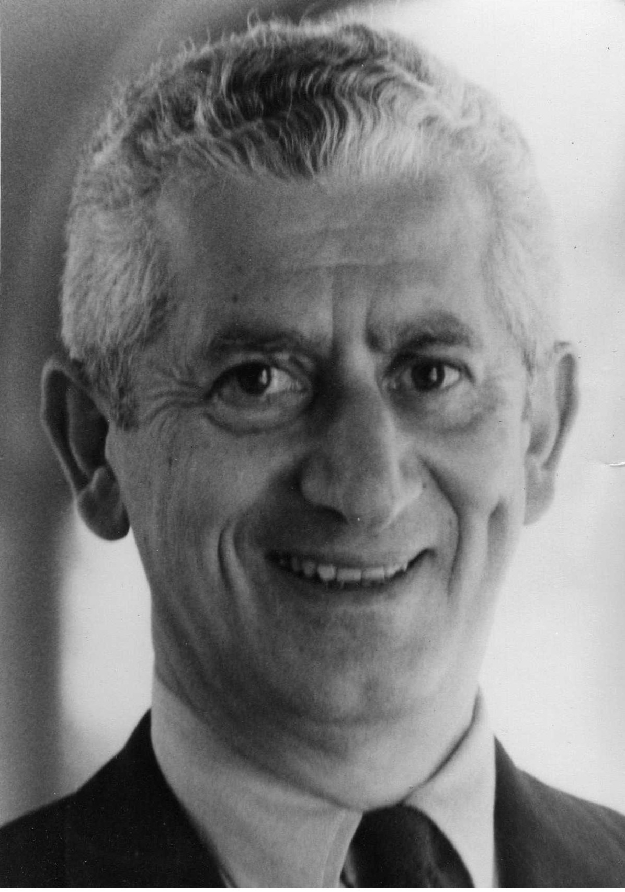
It makes no sense to expect all students to take the same amount of time to achieve the same objectives.
Benjamin Bloom (1912-1999)
American educational psychologist

Slide 18








Online Study Sites

Slide 19


Slide 20
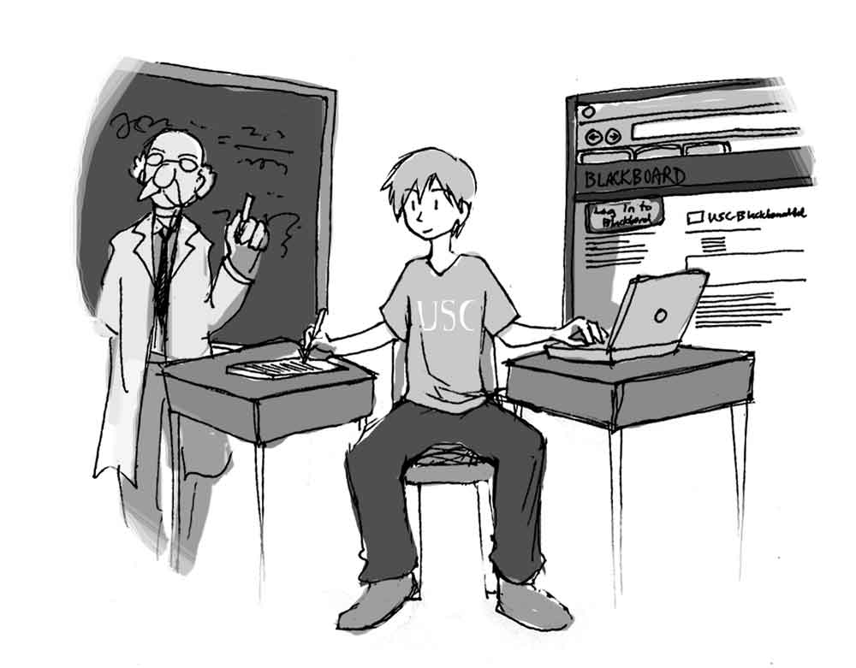
Choosing one

Slide 21


